Slide 1
Chapter 00
Introducing Foundations

Slide 2

Outline
Relative Prime and Prime Factorization [5-6, 9-12, 13-15]
An Extension of Euclid Algorithm [17-25]
Modular Division and Inverse Modulo n Computation [40-45]

Slide 3
Elementary Number-Theoretic Notions
An application of number-theoretic algorithms is in cryptography
the discipline concerned with encrypting a message sent from one party to another, such that someone who intercepts the message will not be able to decode it.
Let the set Z = { …., -2, -1, 0, 1, 2, 3, ….} of integers.
Let the set N = {0, 1, 2, 3, ….} of natural numbers (nonnegative integers.
The notation d | a (read “d divides a”) means
that a = k*d for some integer k, (i.e., a is k multiple of d).

Slide 4
Prime Factorization and Relative Prime

Slide 5
Relatively prime integers
Two integers a and b are relatively prime if, and only if gcd(a, b) = 1, that is, iff their only common divisor is 1.
For example:
8 and 15 are relatively prime, because gcd(8, 15) =1.
gcd(8 15) = 1, because
the divisors of 8 are 1, 2, 4, and 8, and
the divisors of 15 are 1, 3, 5, and 15.

Slide 6
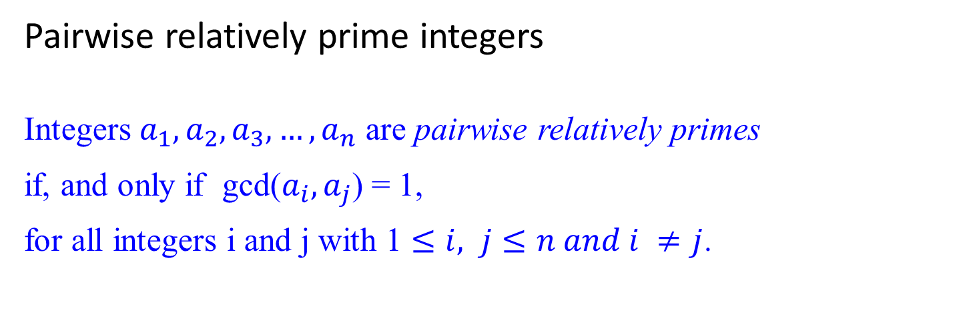
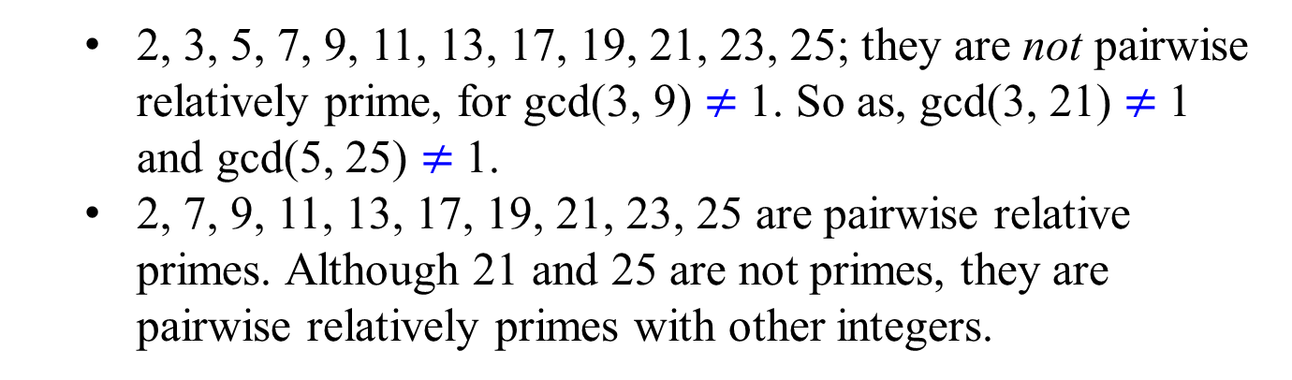
Pairwise relatively prime integers
Integers $a_{1},a_{2},a_{3}, …,a_{n}$ are pairwise relatively primes
if, and only if gcd($a_{i},a_{j}$) = 1,
for all integers i and j with 1 $≤i, j≤n and i ≠j$.
2, 3, 5, 7, 9, 11, 13, 17, 19, 21, 23, 25; they are not pairwise relatively prime, for gcd(3, 9) $≠$1. So as, gcd(3, 21) $≠$1 and gcd(5, 25) $≠$1.
2, 7, 9, 11, 13, 17, 19, 21, 23, 25 are pairwise relative primes. Although 21 and 25 are not primes, they are pairwise relatively primes with other integers.

Slide 7
Prime Factorization and Relative Prime
Every integer greater than one can be written as a unique product of primes.
We next develop theory that proves this assertion.
The following theorem states that if two integers are each relatively prime to an integer p, then their product is relatively prime to p.
Example: Let p = 15, x = 4, y = 16 such that gcd(4, 15) = 1 and gcd(16, 15) = 1. Then gcd(4*16, 15) = 1.

Slide 8
Theorem 0.7
For all primes p and all integers a, b, if p | ab, then p | a or p | b (or both). That is, gcd(a, p) = 1 or gcd(b, p) = 1, but not both.
Example: Let p = 7, x = 5, y = 7 such that 7 | 5*7, and 7 | 7. gcd(5, 7) = 1.
Note: gcd(4, 15) = 1 and gcd(16, 15) = 1. Then gcd(4*16, 15) = 1.
A consequence of Theorem 0.7 is that
every integer n > 1 has a unique factorization as a product of prime numbers.

Slide 9


The following unique factorization theorem is also called the fundamental theorem of arithmetic. Every integer greater than one can be written as a unique product of primes.
Theorem 0.8 (Unique factorization)
There is exactly one way to write any composite integer n as a product of the form
n = $p_{1}^{e_{1}} p_{2}^{e_{2}}… p_{j}^{e_{j}}$,
where the p_{i} are prime, p₁ < p₂ < p₃ < …. < p_{j} , and
the e_{i} are positive integers.
This representation of n is unique.
The integer e_{i} is called the order of p_{i} in n.
?

Slide 10
Theorem 0.9
The gcd(m, n) is a product of the primes that are common to m and n, where the power of each prime in the product is the smaller of its orders in m and n.
Proof: The proof is left as an exercise.
Example 0.40:
300 = 2² x 3¹ x 5² and 1125 = 3² x 5³.
So gcd(300, 1125) = 2⁰ x 3¹ x 5² = 75.
gcd(300, 1125) = 4*300 + (-1)*1125
= 75{4*4 + (-1)*15}, where 0 < 4*4 + (-1)*15 = 1
= 75
?

Slide 11

Algorithm: Compute the Greatest Common Divisor
Theorem 0.9 gives us a straightforward way to compute the greatest common divisor of two (or more) such integers. We simply
find the unique factorizations for each of the two (or more) integers.
determine which primes they have in common, and
determine the greatest common divisor to be a product whose terms are these common primes, where the power of each prime in the product is the smaller of its orders in the two (or more) integers.
The following example illustrated this.
?

Slide 12

Example 0.43:
3,185,325 = 3⁴ x 5² x 11² x 13¹
7,276,500 = 2² x 3³ x 5³ x 7² x 11¹
gcd(3,185,325, 7,276,500) = 3³ x 5² x 11¹ = 7,425.
The problem with this technique is:
Not easy to find the unique factorization of an integer.
Some difficulty factoring these integers in this example.
imagine the difficulty if the integer has 25 digits instead of 7.
no one has ever found a polynomial-time algorithm for determining the factorization of an integer.
?

Slide 13
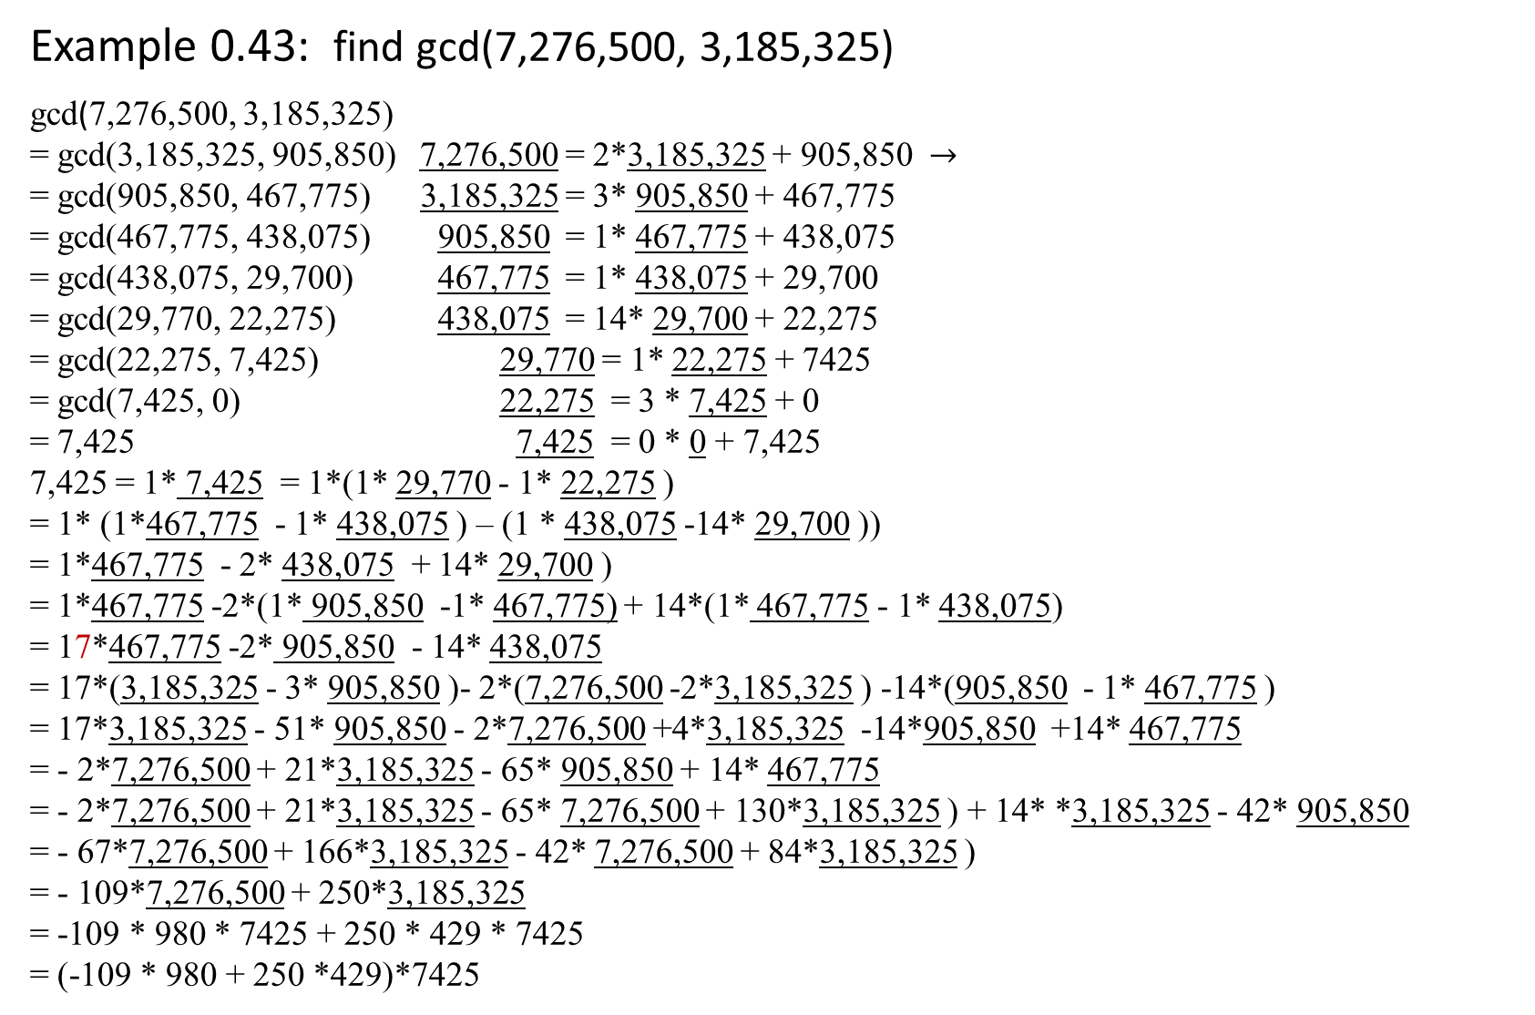
Example 0.43: find gcd(7,276,500, 3,185,325)
gcd(7,276,500, 3,185,325)
= gcd(3,185,325, 905,850) 7,276,500 = 2*3,185,325 + 905,850 $→$
= gcd(905,850, 467,775) 3,185,325 = 3* 905,850 + 467,775
= gcd(467,775, 438,075) 905,850 = 1* 467,775 + 438,075
= gcd(438,075, 29,700) 467,775 = 1* 438,075 + 29,700
= gcd(29,770, 22,275) 438,075 = 14* 29,700 + 22,275
= gcd(22,275, 7,425) 29,770 = 1* 22,275 + 7425
= gcd(7,425, 0) 22,275 = 3 * 7,425 + 0
= 7,425 7,425 = 0 * 0 + 7,425
7,425 = 1* 7,425 = 1*(1* 29,770 - 1* 22,275 )
= 1* (1*467,775 - 1* 438,075 ) – (1 * 438,075 -14* 29,700 ))
= 1*467,775 - 2* 438,075 + 14* 29,700 )
= 1*467,775 -2*(1* 905,850 -1* 467,775) + 14*(1* 467,775 - 1* 438,075)
= 17*467,775 -2* 905,850 - 14* 438,075
= 17*(3,185,325 - 3* 905,850 )- 2*(7,276,500 -2*3,185,325 ) -14*(905,850 - 1* 467,775 )
= 17*3,185,325 - 51* 905,850 - 2*7,276,500 +4*3,185,325 -14*905,850 +14* 467,775
= - 2*7,276,500 + 21*3,185,325 - 65* 905,850 + 14* 467,775
= - 2*7,276,500 + 21*3,185,325 - 65* 7,276,500 + 130*3,185,325 ) + 14* *3,185,325 - 42* 905,850
= - 67*7,276,500 + 166*3,185,325 - 42* 7,276,500 + 84*3,185,325 )
= - 109*7,276,500 + 250*3,185,325
= -109 * 980 * 7425 + 250 * 429 * 7425
= (-109 * 980 + 250 *429)*7425

Slide 14
Euclid’s Algorithm
The recursive Euclid’s algorithm is based on Theorem 0.4.
For any nonnegative integer a and any positive integer b, gcd(a, b) = gcd(b, a mod b).
Algorithm Euclid (m, n)
//Compute gcd(m, n) by Euclid’s algorithm
Input: two non-negative m and n, not both zero integers
Output: the greatest common divisor of m and n
if (n == 0)
then return m;
else Euclid(n, m mod n);
?
the total running time is 2n * O(n² ) = O(n³ )

Slide 15

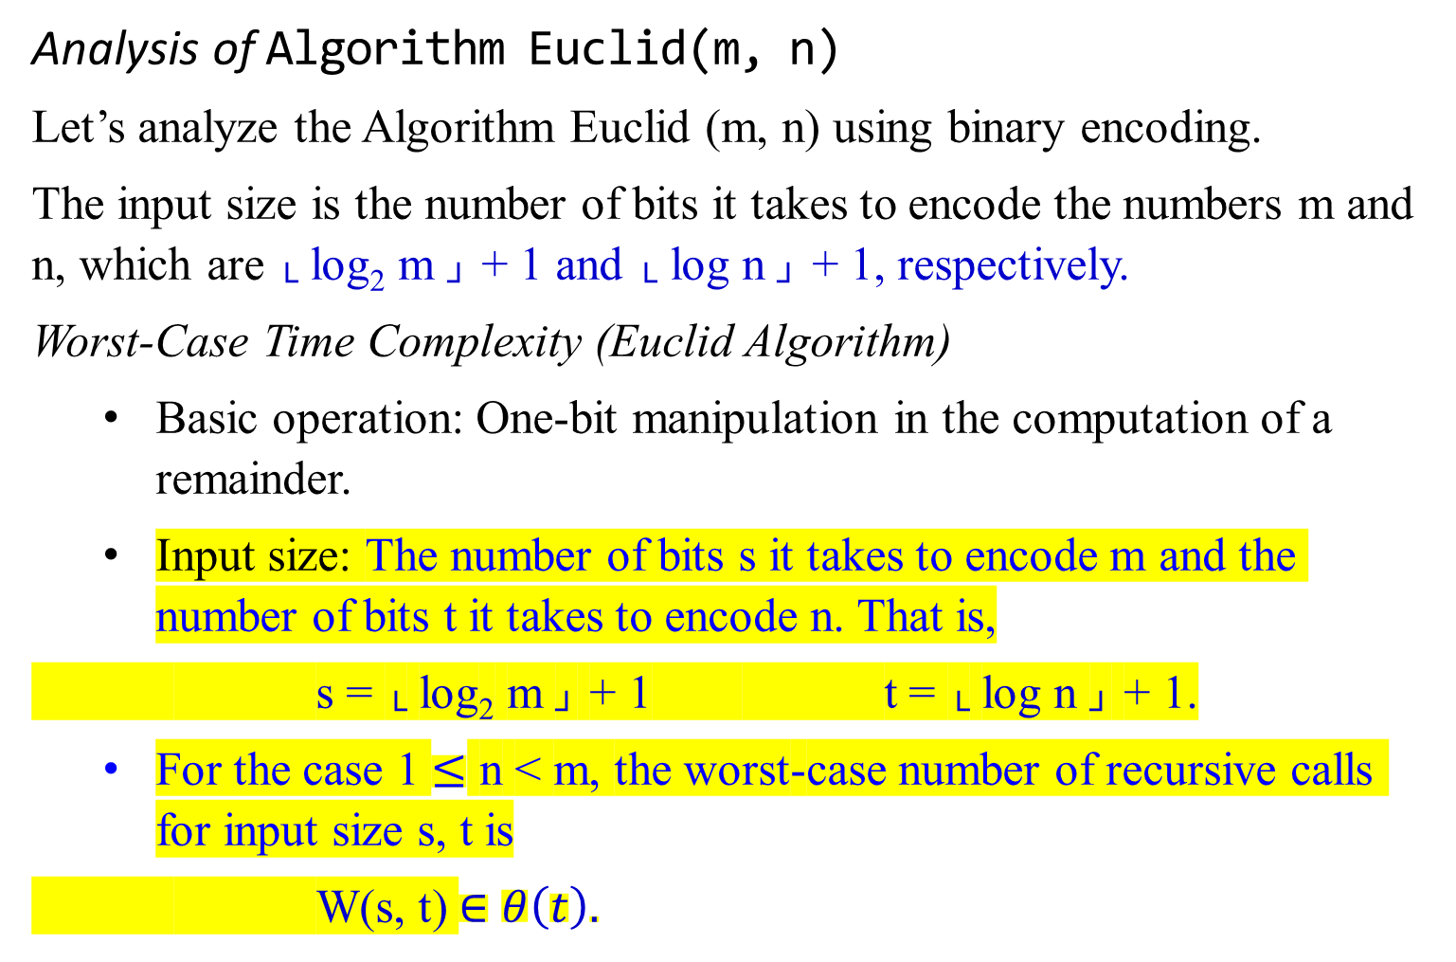
Analysis of Algorithm Euclid(m, n)
Let’s analyze the Algorithm Euclid (m, n) using binary encoding.
The input size is the number of bits it takes to encode the numbers m and n, which are └ log₂ m ┘ + 1 and └ log n ┘ + 1, respectively.
Worst-Case Time Complexity (Euclid Algorithm)
Basic operation: One-bit manipulation in the computation of a remainder.
Input size: The number of bits s it takes to encode m and the number of bits t it takes to encode n. That is,
s = └ log₂ m ┘ + 1 t = └ log n ┘ + 1.
For the case 1 $≤$ n < m, the worst-case number of recursive calls for input size s, t is
W(s, t) $∈θ\left(t\right).$
gcd(15, 11)
= gcd(11, 4) rc
= gcd(4. 3) rc
= ged(3. 1) rc
= gcd(1, 0) rc
= 1
4 recursive calls, for 11 is four bits lone.
gcd(15, 4)
= gcd(4, 3)
= gcd(3. 1)
= gcd(1, 0)
= 1
3 recursive calls.
?

Slide 16
An extension of Euclid Algorithm

Slide 17

a = 64, b = 24, d = 8 is the largest one, but not 2, 4.
An extension of Euclid Algorithm
How can we check that d is claimed to be the GCD(a, b)?
When we check that d | a and d | b, this only shows d to be a common factor, not necessarily the greatest (largest) one
Here is a test that can be used if d = ai + bj for some integers i and j.
Theorem 0.2 states that:
If d | a and d | b, then for integers i and j, d | (ia + jb).
This theorem entails that there are integers i and j such that gcd(a, b) = ia + jb.
recall

Slide 18

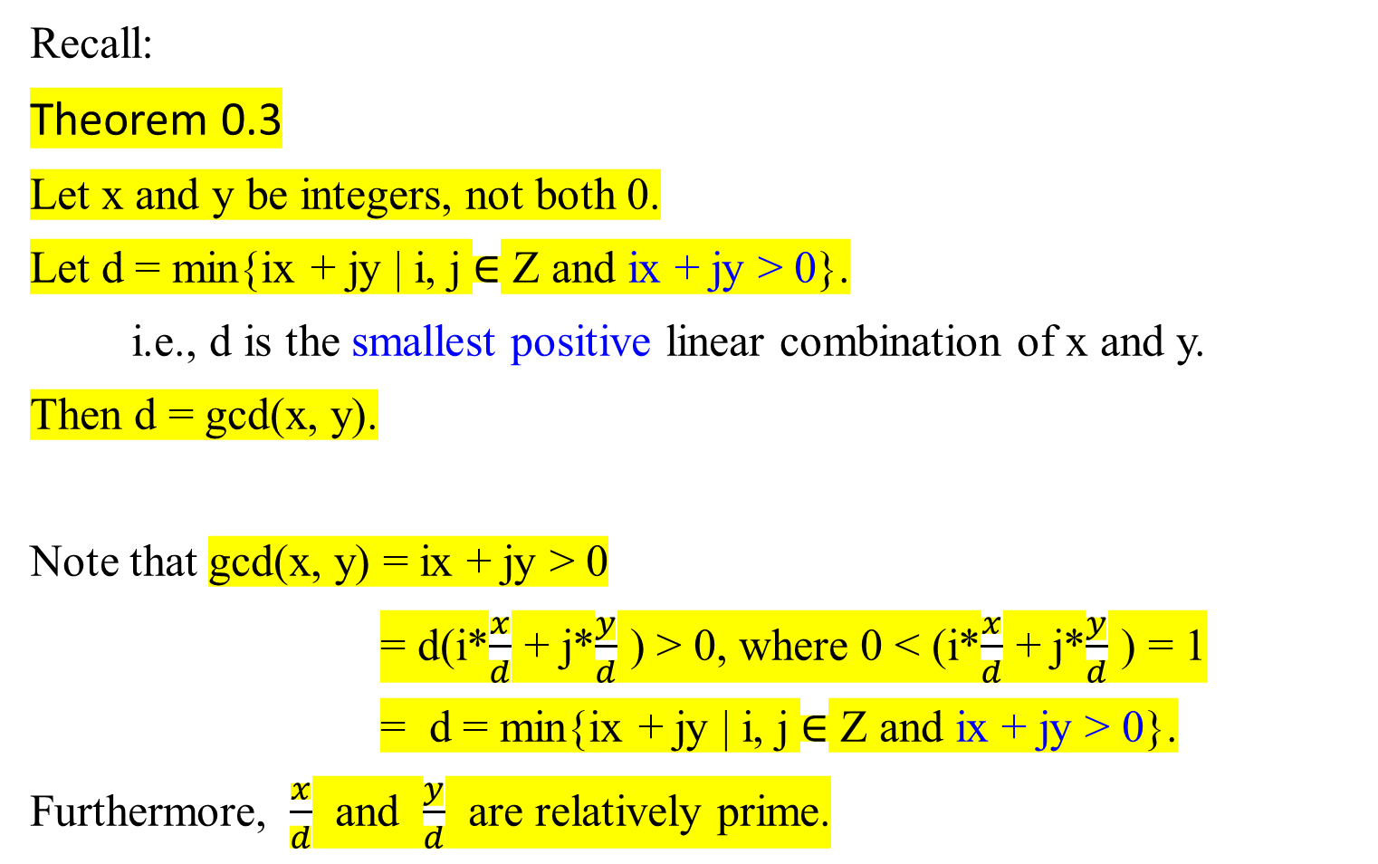
Recall:
Theorem 0.3
Let x and y be integers, not both 0.
Let d = min{ix + jy | i, j $∈$ Z and ix + jy > 0}.
i.e., d is the smallest positive linear combination of x and y.
Then d = gcd(x, y).
Note that gcd(x, y) = ix + jy > 0
= d(i*$\frac{x}{d}$ + j*$\frac{y}{d}$ ) > 0, where 0 < (i*$\frac{x}{d}$ + j*$\frac{y}{d}$ ) = 1
= d = min{ix + jy | i, j $∈$ Z and ix + jy > 0}.
Furthermore, $\frac{x}{d}$ and $\frac{y}{d}$ are relatively prime.
recall

Slide 19
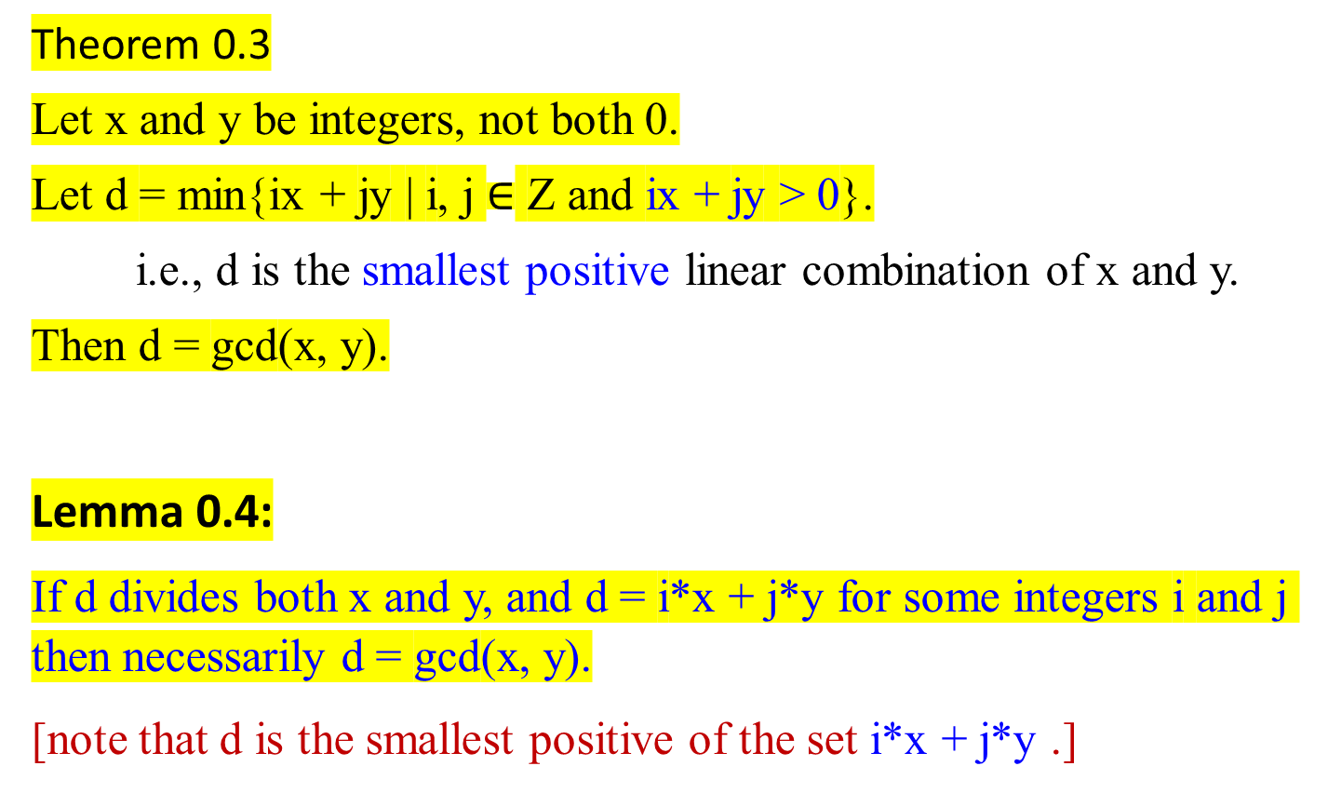
Theorem 0.3
Let x and y be integers, not both 0.
Let d = min{ix + jy | i, j $∈$ Z and ix + jy > 0}.
i.e., d is the smallest positive linear combination of x and y.
Then d = gcd(x, y).
Lemma 0.4:
If d divides both x and y, and d = i*x + j*y for some integers i and j then necessarily d = gcd(x, y).
[note that d is the smallest positive of the set i*x + j*y .]
recall

Slide 20

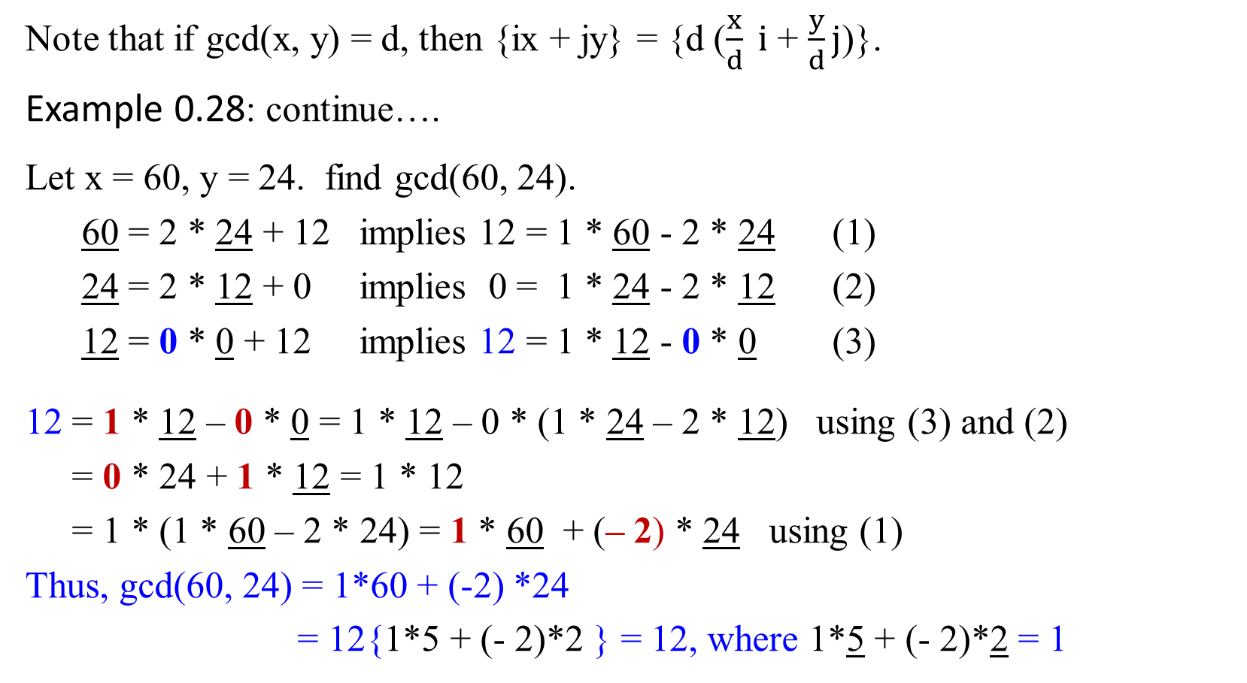
Recall
gcd(60, 24) d=12= min{1*60 + (-2)*24, 3*60 + (-7)*24, …. }
Note that if gcd(x, y) = d, then {ix + jy} = {d ($\frac{x}{d} i$ + $\frac{y}{d}j$)}.
Example 0.28: continue….
Let x = 60, y = 24. find gcd(60, 24).
60 = 2 * 24 + 12 implies 12 = 1 * 60 - 2 * 24 (1)
24 = 2 * 12 + 0 implies 0 = 1 * 24 - 2 * 12 (2)
12 = 0 * 0 + 12 implies 12 = 1 * 12 - 0 * 0 (3)
12 = 1 * 12 – 0 * 0 = 1 * 12 – 0 * (1 * 24 – 2 * 12) using (3) and (2)
= 0 * 24 + 1 * 12 = 1 * 12
= 1 * (1 * 60 – 2 * 24) = 1 * 60 + (– 2) * 24 using (1)
Thus, gcd(60, 24) = 1*60 + (-2) *24
= 12{1*5 + (- 2)*2 } = 12, where 1*5 + (- 2)*2 = 1
gcd(60, 24)
= gcd(24, 60%24)
= gcd(24, 12)
= gcd(12, 24%12)
= gcd(12, 0)
= 12

Slide 21
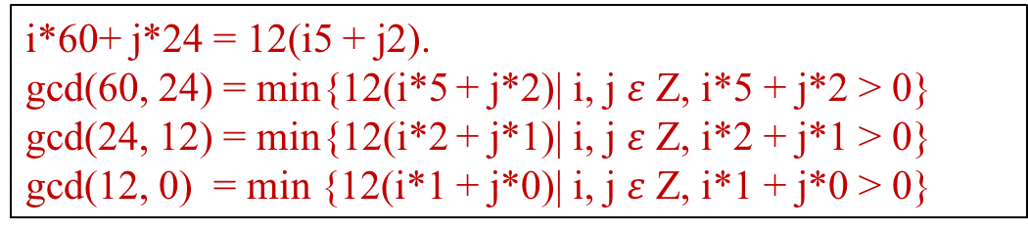
i*60+ j*24 = 12(i5 + j2).
gcd(60, 24) = min{12(i*5 + j*2)| i, j $ε$ Z, i*5 + j*2 > 0}
gcd(24, 12) = min{12(i*2 + j*1)| i, j $ε$ Z, i*2 + j*1 > 0}
gcd(12, 0) = min {12(i*1 + j*0)| i, j $ε$ Z, i*1 + j*0 > 0}
Example 0.45:
We know 12 is the gcd(60, 24). Using the extended Euclid Algorithm, it yields i and j which are stated in the following table.
d_{min} = 1*60 + (-2)*24 = 12(1*5 + (-2)*2) where 1*5 + (-2)*2 = 1 > 0. (3rd step)
d_{min} = 0*24 + 1*12 = 12(0*2 + 1*1) where 0*2 + 1*1 = 1 > 0. (2nd step)
d_{min} = 1*12 + 0*0 = 12(1*1 + 0*0) where 1*1 + 0*0 = 1 > 0. (initial step)
d = i*60 + j*24 = min{12*(i*5 + j*2)| for i, j in Z, i*5 + j*2 >0}
x | y | └ x/y ┘ | gcd | i | j
60 | 24 | 2 | 12 | 1 | -2 | 3rd step
24 | 12 | 2 | 12 | 0 | 1 | 2nd step
12 | 0 | - | 12 | 1 | 0 | 1st step

Slide 22

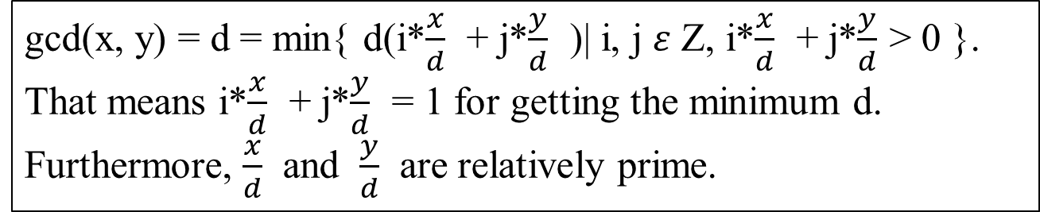
gcd(x, y) = d = min{ d(i*$\frac{x}{d}$ + j*$\frac{y}{d}$ )| i, j $ε$ Z, i*$\frac{x}{d}$ + j*$\frac{y}{d}$ > 0 }.
That means i*$\frac{x}{d}$ + j*$\frac{y}{d}$ = 1 for getting the minimum d.
Furthermore, $\frac{x}{d}$ and $\frac{y}{d}$ are relatively prime.
But when can we find these integer numbers i and j?
Under what circumstance can gcd(x, y) be expressed in this checkable form i*x + j*y > 0?
It turns out that it always can.
What is even better, the coefficients i and j can be found by a small extension to Euclid’s algorithm which is as follows:

Slide 23


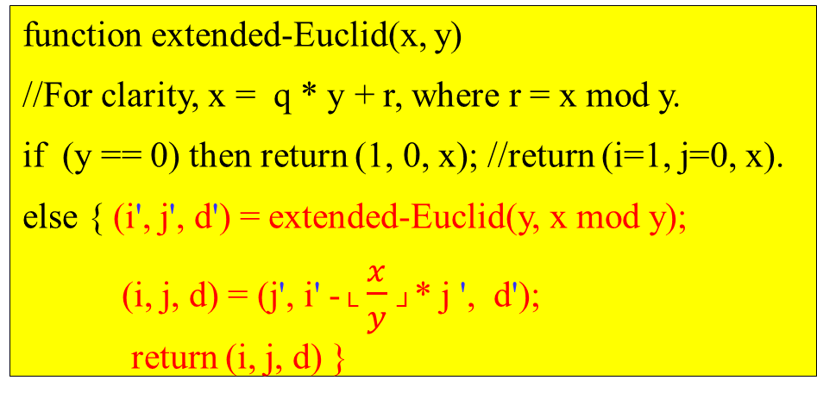
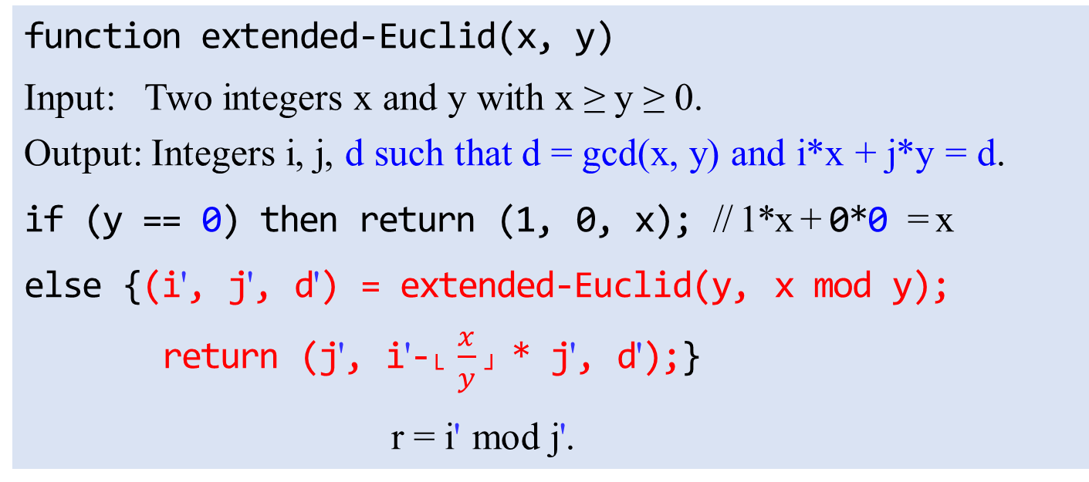
function extended-Euclid(x, y)
//For clarity, x = q * y + r, where r = x mod y.
if (y == 0) then return (1, 0, x); //return (i=1, j=0, x).
else { (i', j', d') = extended-Euclid(y, x mod y);
(i, j, d) = (j', i' -└ $\frac{x}{y}$┘* j ', d');
return (i, j, d) }
Euclid(x, y)
if (y == 0)
then return x;
else Euclid(y, x mod y);
function extended-Euclid(x, y)
Input: Two integers x and y with x ≥ y ≥ 0.
Output: Integers i, j, d such that d = gcd(x, y) and i*x + j*y = d.
if (y == 0) then return (1, 0, x); // 1*x + 0*0 = x
else {(i', j', d') = extended-Euclid(y, x mod y);
return (j', i'-└ $\frac{x}{y}$┘ * j', d');}
r = i' mod j'.

Slide 24
function extended-Euclid(x, y)
//For clarity, x = q * y + r, where r = x mod y.
if y = 0 then return (1, 0, x)
else { (i', j', d') = extended-Euclid(y, x mod y);
(i, j, d) = (j', i' -└ x/y ┘* j', d');
return (i, j, d) }
d = min{12*(i*5 + j*2)| for i, j in Z, i*5 + j*2 >0}
That is, 1*5 + (-2) *2 = 1
function extended-Euclid(x, y)
e-E(x = 60, y = 24)
(i', j', d') = extended-Euclid(24, 60 mod 24 = 12);
return (j', i' -└ x/y ┘* j', d') = (1, 0 - └ 60/24 ┘* 1, 12)
= (1, -2, 12) which is (i', j', d)…. (3)
e-E(x = 24, y =12)
(i', j', d') = extended-Euclid(12, 24 mod 12 = 0);
return (j', i' -└ x/y ┘* j', d') = (0, 1 - └ 24/12 ┘* 0, 12)
= (0, 1, 12) which is (i', j', d) ….. (2)
e-E(x = 12, y = 0)
Since y = 0, return (1, 0, 12) which is (i'=1, j'=0, x=12) …..(1)

Slide 25

Theorem 0.11
For any positive integers a and b, the extended Euclid algorithm returns integers i, j, and d such that gcd(x, y) = d = i*x + j*y.

Slide 26
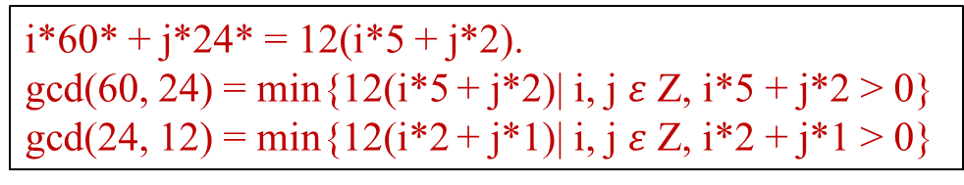
i*60* + j*24* = 12(i*5 + j*2).
gcd(60, 24) = min{12(i*5 + j*2)| i, j $ε$ Z, i*5 + j*2 > 0}
gcd(24, 12) = min{12(i*2 + j*1)| i, j $ε$ Z, i*2 + j*1 > 0}
Consider Example 0.45:
We know 12 is the gcd(60, 24). The reason is that 60*1 + 24*(-2) = 12, or 60*(-1) + 24*3 = 12, or 60*(3) + 24*-7 = 12, (which is the least positive).
However, we know 3 | 60 and 3 | 24. But 3 is not the gcd(60, 24) for there is no integers i and j such that i*60 + j*24 = 3.
The following table can be obtained by the computation as follows:
i*60 + j*24* = min{12(i*5 + j*2)| for i, j in Z, i*5 + j*2 >0}
x | y | └ x/y ┘ | gcd | i | j
60 | 24 | 2 | 12 | 3 | -7 | 3rd step
24 | 12 | 2 | 12 | -1 | 3 | 2nd step
12 | 0 | - | 12 | 1 | 0 1 | 1st step

Slide 27

Consider Example 0.45 (contd.):
To compute gcd(60, 24), based on (x = q * y + r), where r = x mod y.
Euclid’s algorithm would proceed as follows:
gcd(60, 24) 60 = 2 * 24 + 12 $→$12 = 1 * 60 – 2 * 24 (3rd step)
= gcd(24, 12) 24 = 2 * 12 + 0 $→$ 0 = 1 * 24 – 2 * 12 (2nd step)
= gcd(12, 0) 12 = 1 * 0 + 12 $→$ 12 = 1 * 12 – 1 * 0 (1st step)
= 12
At each step, the gcd computation has been reduced to the underlined numbers. Thus, gcd(60, 24) = gcd(24, 12) = gcd(12, 0) = 12.
To find i and j such that i*60 + j*24 = 12, we start by expressing 12 in terms of the last pair (12, 0). Then we work backwards and express it in terms of (24, 12), and finally (60, 24). The process is as follows:

Slide 28
(x = q * y + r), where r = x mod y. r = x – q * y.
gcd(60, 24) 60 = 2 * 24 + 12 12 = 60 – 2 * 24 .…(3)
gcd(24, 12) 24 = 2 * 12 + 0 0 = 24 – 2 * 12 .…(2)
gcd(12, 0) 12 = 1 * 0 + 12 12 = 12 – 1 * 0 …..(1)
= 12
The first step is: use the last line on the gcd computation
12 = 1 * ­12 – 1 * 0. …..(1) (i.e., based on r = x – q * y)}
The second step is: use the second last line on the gcd computation
0 = 1 * 24 – 2 * 12 ….. (2) to replace 0 in (1)
to get 12 = 1 * 12 – (1 * 24 – 2 * 12)
= 1 * 12 – 1 * 24 + 2 * 12
= –1 * 24 + 3 * 12. ….(2a)
The final step is: use the first line on the gcd computation
12 = 1 * 60 – 2 * 24 …..(3) to replace 12 in (2a).
to get 12 = –1 * 24 + 3 * (1* 60 - 2 * 24 )
= 3 * 60 – 7 * 24 ….. (3a)
gcd(60, 24) = 3 * 60 – 7 * 24 = 12(3 * 5 – 7 *2) = 12

Slide 29

Example 0.43:
If we can supply two numbers x and y such that d = a*i + b*j, then we can be sure d = gcd(a, b). For instance, we know 1 is the gcd(13, 4), that is, gcd(13, 4) = 1. The reason is that 13 * 1 + 4 *(-3) = 1 (which is the least positive).
Using function extended-Euclid(13, 4), we have the following table:
1 = gcd(13, 4) = 1 = 13 * 1 + 4 *(-3).
Without applying the extended algorithm, we could find i = 5, j = -16. i.e., gcd(13, 4) = 1 = 13*5 + 4*(-16) = 1 > 0.
For (i, j) $∈\text{\{(−3, 10), }\text{(1, −3), }\text{(5, −16), }\text{…\}}\text{, }\text{d}\text{ = }\text{min}\text{\{}$1*(13i + 4j) | i, j $∈$ Z, (13i + 4j) > 0}. This implies that for any pair (i, j) which yields 13i + 4j =1.
x | y | └ x/y ┘ | gcd | i | j
13 | 4 | 3 | 1 | 1 | -3
4 | 1 | 4 | 1 | 0 | 1
1 | 0 | - | 1 | 1 | 0

Slide 30
function extended-Euclid(a, b)
//For clarity, x= q * y + r, where r = x mod y.
if y = 0 then return (1, 0, x)
else { (i’, j’, d’) = extended-Euclid(y, x mod y);
(i, j, d) = (j’, i’ -└ x/y ┘* j’, d’);
return (i, j, d) }
d = min{1*(13i + 4j)| for i, j in Z, 13i + 4j >0}
That is, 13 * 1 + 4 * -3 = 1
E(x = 13, y = 4)
(i’, j’, d’) = extended-Euclid(4, 13 mod 4 = 1);
return (j’, i’ -└ x/y ┘* j’, d’) = (1, 0 - └ 13/4 ┘ * 1, 1)
= (1, -3, 1) is (i, j, d) …..(3)
E(x = 4, y =1)
(i’, j’, d’) = extended-Euclid(4, 4 mod 1 = 0);
return (j’, i’ -└ x/y ┘* j’, d’) = (0, 1 - └ 4/1 ┘ * 0, 1)
= (0, 1, 1) (i’, j’, d’) …..(2)
E(a = 1, b = 0)
Since b = 0, return (1, 0, 1) …..(1)

Slide 31
Consider Example 0.43:
To compute gcd(13, 4), Euclid’s algorithm would proceed as follows:
13 = 3 * 4 + 1 (x = q * y + r), where r = x mod y
4 = 4 * 1 + 0 gcd(4, 1)
1 = 1 * 0 + 1 gcd(1, 0) = 1
At each step, the gcd computation has been reduced to the underlined numbers.
Thus, gcd(13, 4) = gcd(4, 1) = gcd(1, 0) = 1.
To find x and y such that 13*i + 4*j = 1, we start by expressing 1 in terms of the last pair (1, 0). Then we work backwards and express it in terms of (4, 1), and finally (13, 4).

Slide 32
The first step is: we use the last line 1 = 1 * 0 + 1 to get
1 = 1 – 1 * 0 (i.e., based on r = x – q * y)}
1 = 1 – 1 * 0 = 1 * ­1 – 1 * 0. …..(1)
To rewrite this in terms of (4, 1), we use substitution 0 = 1 * 4 - 4 * 1 (i.e., r = x – q * y), which is obtained by from the second last line on the gcd calculation
4 = 4 * 1 + 0
0 = 1 * 4 - 4 * 1
to get 1 = 1 * 1 – 1* (1*4 - 4 *1)
= 1 * 1 – 1 * 4 + 4 * 1
= – 1 * 4 + 5 * 1 …..(2)
The final step is to use substitution 1 = 1*13 - 3 * 4, which is obtained by from the first one on the gcd calculation
13 = 3 * 4 + 1
1 = 1* 13 - 3 * 4
to get 1 = – 1 * 4 + 5 * (1* 13 - 3 * 4 )
= 5 * 13 - 16 * 4 …..(3)
13 = 3 * 4 + 1 (x = q * y + r), where r = x mod y
4 = 4 * 1 + 0 gcd(4, 1)
1 = 1 * 0 + 1 gcd(1, 0) = 1

Slide 33
The first step is: we use the last line 1 = 1 * 0 + 1 to get
1 = 1 – 1 * 0 (i.e., based on r = a – q * b)}
1 = 1 – 1 * 0 = 1 * ­1 – 1 * 0.
To rewrite this in terms of (4, 1), we use substitution 0 = 1 * 4 - 4 * 1 (i.e., r = a – q * b), which is obtained by from the second last line on the gcd calculation
4 = 4 * 1 + 0
0 = 1 * 4 - 4 * 1
to get 1 = 1 * 1 – (1*4 - 4 *1)
= 1 * 1 – 1 * 4 + 4 * 1
= – 1 * 4 + 5 * 1
The final step is to use substitution 1 = 1*13 - 3 * 4, which is obtained by from the first one on the gcd calculation
13 = 3 * 4 + 1
1 = 1* 13 - 3 * 4
to get 1 = – 1 * 4 + 5 * (1* 13 - 3 * 4 )
= 5 * 13 - 16 * 4
13 = 3 * 4 + 1 (a = q * b + r), where r = a mod b
4 = 4 * 1 + 0 gcd(4, 1)
1 = 1 * 0 + 1 gcd(1, 0) = 1
Using the pairs of blue colored numbers to complete i and j as in the table.

Slide 34
Now Example 0.43 is as follows:
If we can supply two numbers x and y such that d = i*x+ j*y, then we can be sure d = gcd(x, y). For instance, we know 1 is the gcd(13, 4), that is, gcd(13, 4) = 1. The reason is that 13 * 1 + 4 *(-3) = 1 (which is the least positive).
Using function extended-Euclid(13, 4), we have the following table:
1 = gcd(13, 4) = min {(13 * 5 + 4 *(-16)) | 13 * 5 + 4 *(-16) = 1 > 0} .
If apply the extended algorithm, i = 5, j = -16.
i.e., gcd(13, 4) = 1 = 13*5 + 4*(-16). (i, j) = {(5, -16), (1, -3), …} = min {1*(13i + 4j) | (13i + 4j) >0}. This implies that for any pair (i, j), 13i + 4j =1.
x | y | └ x/y ┘ | gcd | i | j
13 | 4 | 3 | 1 | 5 | -16 | 3rd step
4 | 1 | 4 | 1 | -1 | 5 | 2nd step
1 | 0 | - | 1 | 1 | -1 | 1st step

Slide 35


Example 0.46:
To compute gcd(25, 11), Euclid’s algorithm would proceed as follows:
(x = q * y + r), where r = x mod y
gcd(25, 11) 25 = 2 * 11 + 3 $→$ 3 = 1 * 25 – 2 * 11
= gcd(11, 3) 11 = 3 * 3 + 2 $→$ 2 = 1 * 11 – 3 * 3
= gcd( 3, 2) 3 = 1 * 2 + 1 $→$ 1 = 1 * 3 – 1 * 2.
= gcd( 2, 1) 2 = 2 * 1 + 0 $→$ 0 = 1 * 2 – 2 * 1
= gcd( 1, 0) 1 = 1 * 0 + 1 $→$ 1 = 1 * ­ 1 – 1 * 0.
= 1
At each step, the gcd computation has been reduced to the underlined numbers.
M

Slide 36

25 = 2 * 11 + 3 gcd(25, 11)
11 = 3 * 3 + 2 gcd(11, 3)
3 = 1 * 2 + 1 gcd( 3, 2)
2 = 2 * 1 + 0 gcd( 2, 1)
1 = 1 * 0 + 1 gcd( 1, 0) = 1
To find x and y such that 25*i + 11*j = 1, we start by
expressing 1 in terms of the last pair (1, 0). Then we
work backwards and express it in terms of (2, 1), (3, 2),
(11, 3) and finally (25, 11).
The first step is: use the last line 1 = 1 * 0 + 1 to get
1 = 1 – 1 * 0 = 1 * ­1 – 1 * 0. ….(1)
The second step is: use the 2nd last line 2 = 2 * 1 + 0, i.e., 0 = 2 - 2 * 1
to replace 0 in (1)
Then, 1 = 1 * ­1 – 1 * 0. from (1)
= 1 * 1 – 1 * (2 – 2 * 1) = 1 * 1 – 1 * 2 + 2 * 1
= -1 * 2 + 1 * 1 + 2 * 1 = -1 * 2 + 3 * 1. ….(2)

Slide 37

The 3rd step is: Use the 3rd last line 3 = 1 * 2 + 1 which yields 1 = 3 – 1 * 2. Substituting this in
1 = -1 * 2 + 3 * 1 ….(2)
= -1 * 2 + 3 * (3 – 1 * 2)
= 3 * 3 – 4 * 2 …..(3)
Continuing in this same way with substitutions 2 = 11 – 3 * 3 and then 3 = 25 – 2 *11 into (3) and (4) gives
1 = 3 * 3 – 4 * 2 from (3)
= 3 * 3 – 4 * (11 – 3 * 3)
= -4 * 11 + 15 * 3 …..(4)
= -4 * 11 + 15 * (25 – 2 *11)
= 15 * 25 – 34 * 11 …..(5)
25 = 2 * 11 + 3 gcd(25, 11)
11 = 3 * 3 + 2 gcd(11, 3)
3 = 1 * 2 + 1 gcd(3, 2)
2 = 2 * 1 + 0 gcd( 2, 1)
1 = 1 * 0 + 1 gcd(1, 0) = 1

Slide 38

We are done: 15 * 25 – 34 * 11 = 1, so i = 15 and j = -34.
That means, gcd(25, 11) = 25 *15 + 11*(-34) = 1
Using function extended-Euclid(25, 11) we obtained the following table:
Thus, the gcd(25, 11) = 1 = min { 1*( 15 * 25 – 34 * 11) | 15 * 25 – 34 * 11 > 0}.
Note that the values for (i, j) are not unique for the same (x, y)
x | y | └ x/y ┘ | d = gcd | i | j
25 | 11 | 2 | 1 | 15 | -34 | 5th step
11 | 3 | 3 | 1 | -4 | 15 | 4th step
3 | 2 | 1 | 1 | 3 | -4 | 3rd step
2 | 1 | 1 | 1 | -1 | 3 | 2nd step
1 | 0 | - | 1 | 1 | -1 | 1st step

Slide 39
Modular Division

Slide 40
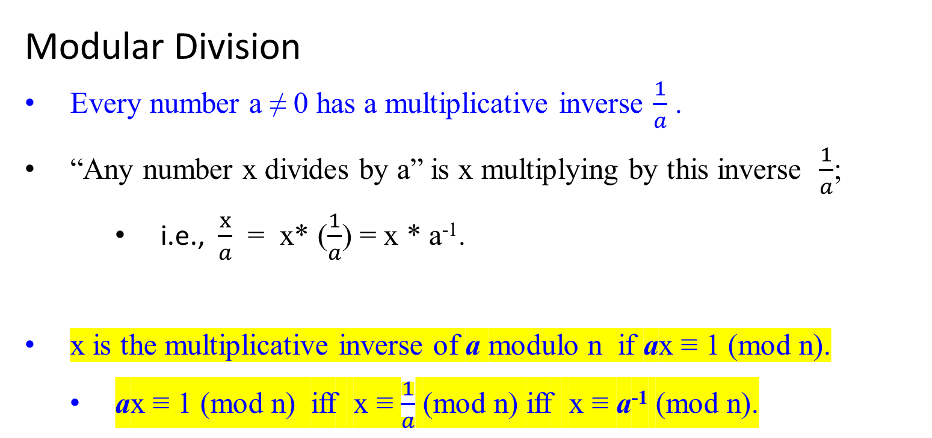
ax and 1 are equivalent mod n.
ax and 1 are congruent mod n.
ax is congruent to 1 mod n.
n | ax – 1 or n| 1 – ax.
Modular Division
Every number a ≠ 0 has a multiplicative inverse $\frac{1}{a}$ .
“Any number x divides by a” is x multiplying by this inverse $\frac{1}{a}$;
i.e., $\frac{x}{a}$ = x* ($\frac{1}{a}$) = x * a⁻¹.
x is the multiplicative inverse of a modulo n if ax ≡ 1 (mod n).
ax ≡ 1 (mod n) iff x ≡ $\frac{1}{a}$ (mod n) iff x ≡ a⁻¹ (mod n).

Slide 41
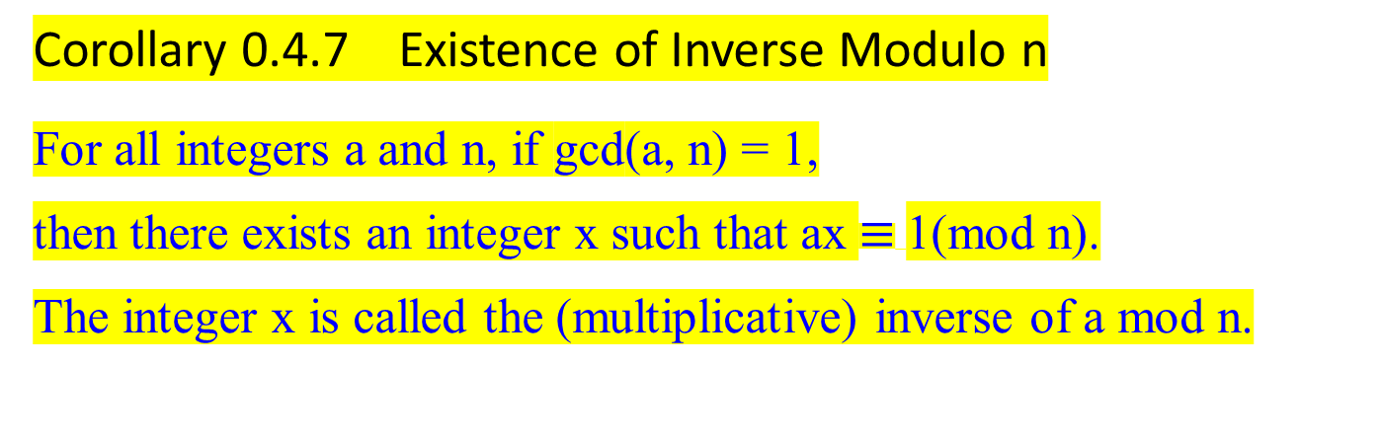
Corollary 0.4.7 Existence of Inverse Modulo n
For all integers a and n, if gcd(a, n) = 1,
then there exists an integer x such that ax $≡$1(mod n).
The integer x is called the (multiplicative) inverse of a mod n.
i.e., n | ax – 1 or n| 1 – ax.

Slide 42

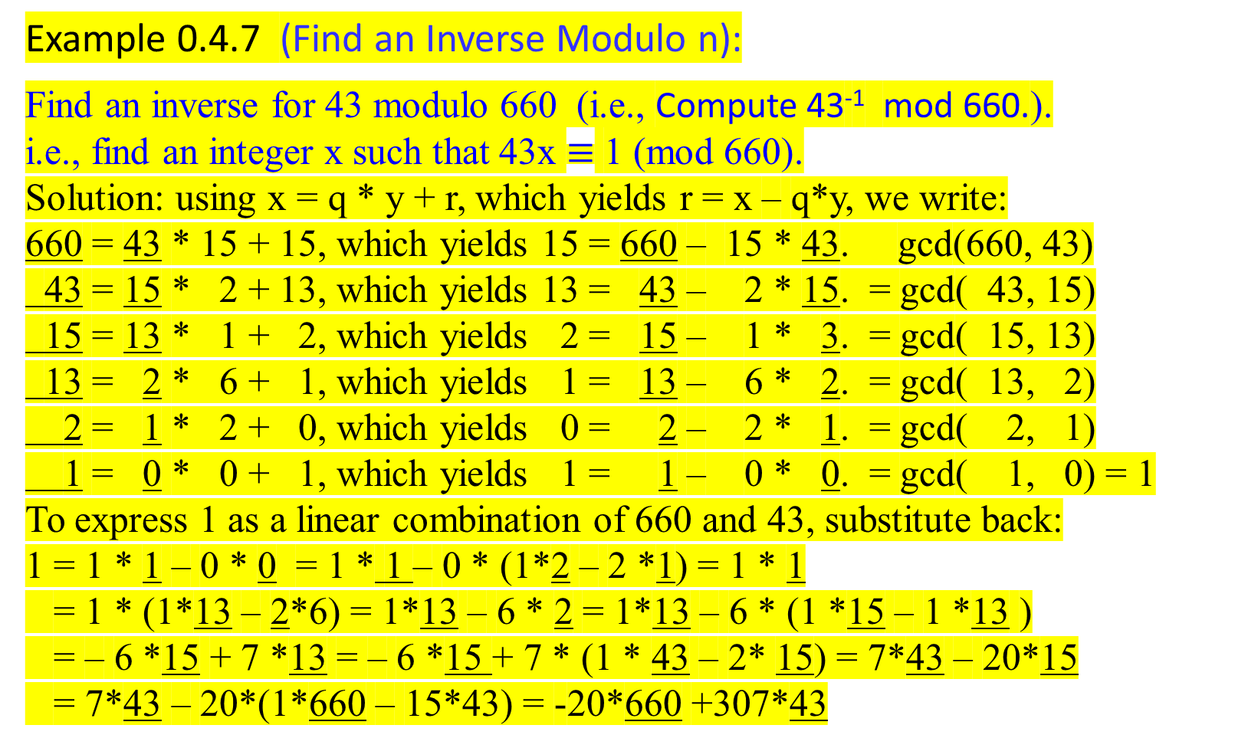
Example 0.4.7 (Find an Inverse Modulo n):
Find an inverse for 43 modulo 660 (i.e., Compute 43⁻¹ mod 660.).
i.e., find an integer x such that 43x $≡$ 1 (mod 660).
Solution: using x = q * y + r, which yields r = x – q*y, we write:
660 = 43 * 15 + 15, which yields 15 = 660 – 15 * 43. gcd(660, 43)
43 = 15 * 2 + 13, which yields 13 = 43 – 2 * 15. = gcd( 43, 15)
15 = 13 * 1 + 2, which yields 2 = 15 – 1 * 3. = gcd( 15, 13)
13 = 2 * 6 + 1, which yields 1 = 13 – 6 * 2. = gcd( 13, 2)
2 = 1 * 2 + 0, which yields 0 = 2 – 2 * 1. = gcd( 2, 1)
1 = 0 * 0 + 1, which yields 1 = 1 – 0 * 0. = gcd( 1, 0) = 1
To express 1 as a linear combination of 660 and 43, substitute back:
1 = 1 * 1 – 0 * 0 = 1 * 1 – 0 * (1*2 – 2 *1) = 1 * 1
= 1 * (1*13 – 2*6) = 1*13 – 6 * 2 = 1*13 – 6 * (1 *15 – 1 *13 )
= – 6 *15 + 7 *13 = – 6 *15 + 7 * (1 * 43 – 2* 15) = 7*43 – 20*15
= 7*43 – 20*(1*660 – 15*43) = -20*660 +307*43

Slide 43

We find 307* 43 – 20 *660 = 1.
307* 43 = 1+ 20 *660.
Thus by definition of congruence modulus 660, and Theorem 0.1.4.1
307* 43 (mod 660) = (1 + 20 *660) (mod 660)
307* 43 (mod 660) = (1 (mod 660) + 20 *660 (mod 660)) (mod 660) .
307* 43 (mod 660) = (1 (mod 660) + 0)(mod 660)
307* 43 (mod 660) = (1 mod 660) mod 660
307* 43 (mod 660) = 1 mod 660
307* 43 $≡$ 1(mod 660).
307 $≡$ ${43}^{−1}$(mod 660).
So 307 is the inverse (i.e., the multiplicative inverse) of 43 modulo 660.
Note that 307*43 (= 13201) is an element of the equivalence class modulo 660 containing an integer 1, [1]₆₆₀ where [a]_{n} = {a + i * n | i ɛ Z}. For this case i =20

Slide 44

Example: 0.4.7.1
Find a positive inverse for 3 modulo 40.
That is, find a positive integer x such that 3x $≡$ 1(mod 40).
Solution:
Find a linear combination of 3 and 40 that equals 1.
40 = 13 * 3 + 1 which yields 1 = 1 * 40 – 13 * 3. gcd(40, 3)
3 = 3 * 1 + 0 which yields 0 = 1 * 3 – 3 * 1 = gcd(3, 1)
1 = 0 * 0 + 1 which yields 1 = 1 * 1 – 0 * 0 = gcd(1, 0) = 1.
Since 1 = 1 * 40 – 13 * 3, then
1 = 1 * 1 - 0 * 0 yields 1 = 1 * (40 – 13 * 3). Linear combination of 40 and 3.
This yields (-13)* 3 = 1 + (-1)*40 .
By definition of congruence modulo n,
(-13)* 3 (mod 40) = (1 mod 40 + (-1)*40 mod 40) mod 40.
(-13)* 3 $≡$1(mod 40).
This result implies that -13 is an inverse for 3 mod 40. In symbol, (-13)* 3 $≡$1(mod 40).
To find a positive inverse, compute 40 -13 which yields 27, and 27 $≡(−13)$(mod 40) because 27 – (-13) = 40. So, by Theorem 0.1.4.3(3. ab $≡$ cd (mod n),
27 * 3 $≡$ (-13) *3 $≡$ (1 mod 40),
and thus by the transitive property of congruence modulo n, 27 is a positive integer that is an inverse for 3 modulo 40.

Slide 45


Example: 0.4.7.1 [another crazy way]
Find a positive inverse for 3 modulo 40.
That is, find a positive integer x such that 3x $≡$ 1(mod 40).
Solution:
Find a linear combination of 3 and 40 that equals 1.
40 = 13 * 3 + 1. This yields 1 = 1 * 40 – 13 * 3. gcd(40, 3)
3 = 3 * 1 + 0. This yields 0 = 1 * 3 – 3 * 1. = gcd( 3, 1)
1 = 1 * 0 + 1. This yields 1 = 1 * 1 – 0 * 0. = gcd( 1, 0) = 1. (What if?)
Since 4 * 40 = 53 * 3 + 1, then 1 = 4 * 40 + (-53) * 3 .
by definition of congruence modulo n, and Theorem 0.1.4.1 (modular equivalence)
(-53)* 3 $≡$1(mod 40).
This result implies that -53 is an inverse for 3 mod 40. In symbol, -53 $≡ 3^{−1}$(mod 40).
To find a positive inverse, compute -53 + 40 = -13, and then -13 + 40 = 27.
27 * 3 $≡$(-13) *3 $≡$ (-53) * 3 $≡$ (1 mod 40),
Then -53, -13 and 27 are the inverse of 3 modulo 40. Therefore, 27 is a positive integer, that is an inverse for 3 modulo 40.

Slide 46

Example 0.52: Compute 11⁻¹ mod 25.
gcd(25, 11) = gcd(11, 25 mod 11) = gcd (11, 3)
= gcd( 3, 11 mod 3) = gcd( 3, 2)
= gcd( 2, 3 mod 2) = gcd( 2, 1)
= gcd( 1, 2 mod 1) = gcd( 1, 0) = 1.
Thus, gcd(25, 11) = 1.
Using extended Euclid’s Algorithm, we have
gcd(25, 11) = 15 * 25 + (-34) * 11 = 1,
where a = 25 and b = 11, and x = 15 and y = -34. (see example 0.46)
What is the multiplicative inverse of 11 modulo 25?
i.e., find x such that 11x ≡ 1 mod 25. equivalently, 25 | (11x – 1).

Slide 47


Example 0.52: Compute 11⁻¹ mod 25.
…
Reduce both sides of 25 * 15 + 11 * (-34) = 1 by mod 25.
We have (25 * 15 + 11 * (-34)) mod 25 ≡ 1 mod 25.
((25 * 15) mod 25 + (11 * (-34)) mod 25) mod 25 ≡ 1 mod 25,
where 25 *15 mod 25 = 0.
(11 * (-34)) mod 25) mod 25 ≡ 1 mod 25,
11 * (-34) mod 25 = 1,
Therefore, 1 is generated by 11*(-34) mod 25. [i.e., 25 divides (-34 * 11 – 1) ].
And we write -34 * 11 ≡ 1 mod 25.
-34 ≡ $\frac{1}{11}$ mod 25.
-34 ≡ 11⁻¹ mod 25.
By definition, -34 is the multiplicative inverse of 11 mod 25.
This concludes that -34 is 11⁻¹modulo 25.
Or -34 + 25 + 25 = 16 is 11⁻¹modulo 25. QED

Slide 48

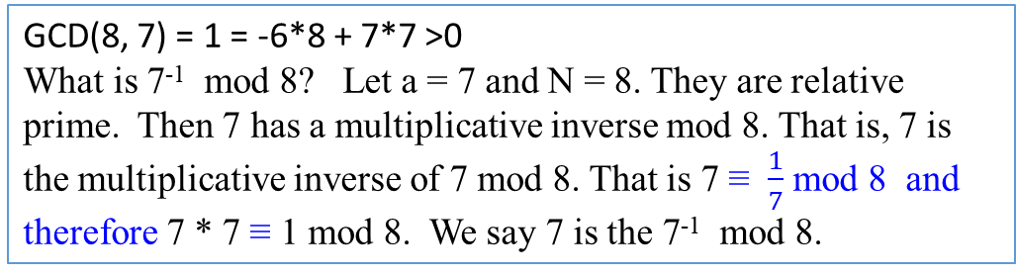
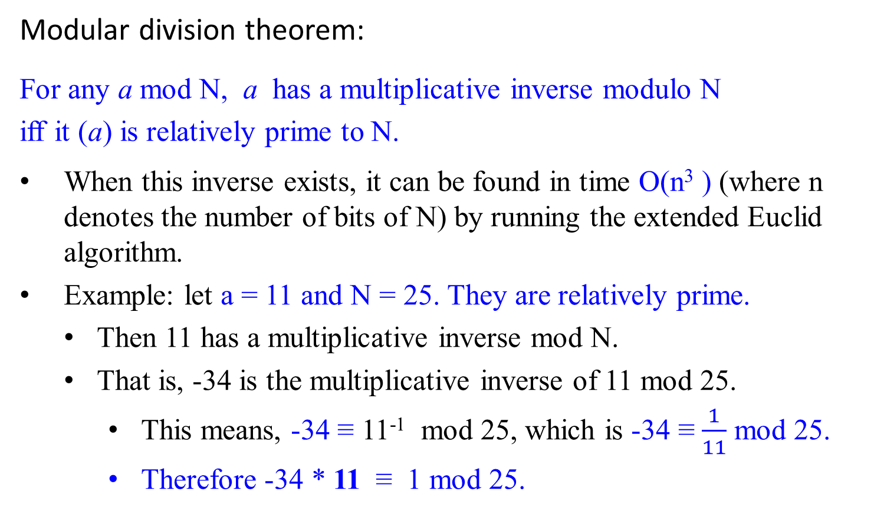
GCD(8, 7) = 1 = -6*8 + 7*7 >0
What is 7⁻¹ mod 8? Let a = 7 and N = 8. They are relative prime. Then 7 has a multiplicative inverse mod 8. That is, 7 is the multiplicative inverse of 7 mod 8. That is 7 ≡ $\frac{1}{7}$ mod 8 and therefore 7 * 7 ≡ 1 mod 8. We say 7 is the 7⁻¹ mod 8.
Modular division theorem:
For any a mod N, a has a multiplicative inverse modulo N
iff it (a) is relatively prime to N.
When this inverse exists, it can be found in time O(n³ ) (where n denotes the number of bits of N) by running the extended Euclid algorithm.
Example: let a = 11 and N = 25. They are relatively prime.
Then 11 has a multiplicative inverse mod N.
That is, -34 is the multiplicative inverse of 11 mod 25.
This means, -34 ≡ 11⁻¹ mod 25, which is -34 ≡ $\frac{1}{11}$ mod 25.
Therefore -34 * 11 ≡ 1 mod 25.

Slide 49
Primality testing

Slide 50
Cryptography – The RSA Public Key Cryptosystem
The Rivest-Shamir-Adleman (RSA) cryptosystem uses all the ideas we have introduced in this lecture note. It derives very strong guarantees of security by ingeniously exploiting the wide gulf between the polynomial-time computability of certain number-theoretic tasks: (
modular exponentiation,
greatest common divisor,
primality testing) and
the intractability of others (factoring).
113

